Slide 1
Biological timing responses in animals

Slide 2
Biological Clocks
Used by animals for:
Controlling daily rhythms, e.g. sleep
Synchronising breeding times
Predicting and preparing for migration, hibernation
Time compensation for navigation
Prediction of changes in the environment, e.g. day/night, tides, seasons

Slide 3
Where is it?
Reptiles and birds – the pineal gland in the brain can detect light directly
Mammals – in the suprachiasmatic nuclei of the hypothalamus. (see next slide)

Slide 4
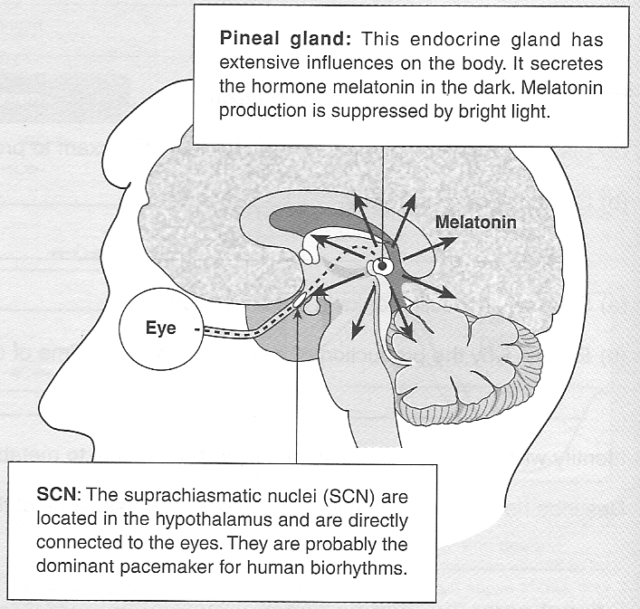

Slide 5
Circadian rhythms in animals
Diurnal – active in day, inactive at night
Nocturnal – active at night, inactive in day
Crepuscular – active twilight – dawn and or dusk
Arrhythmic – no regular pattern e.g. deep ocean or caves.

Slide 6
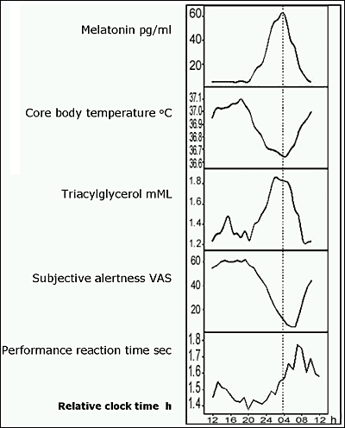
Some human circadian rhythms

Slide 7
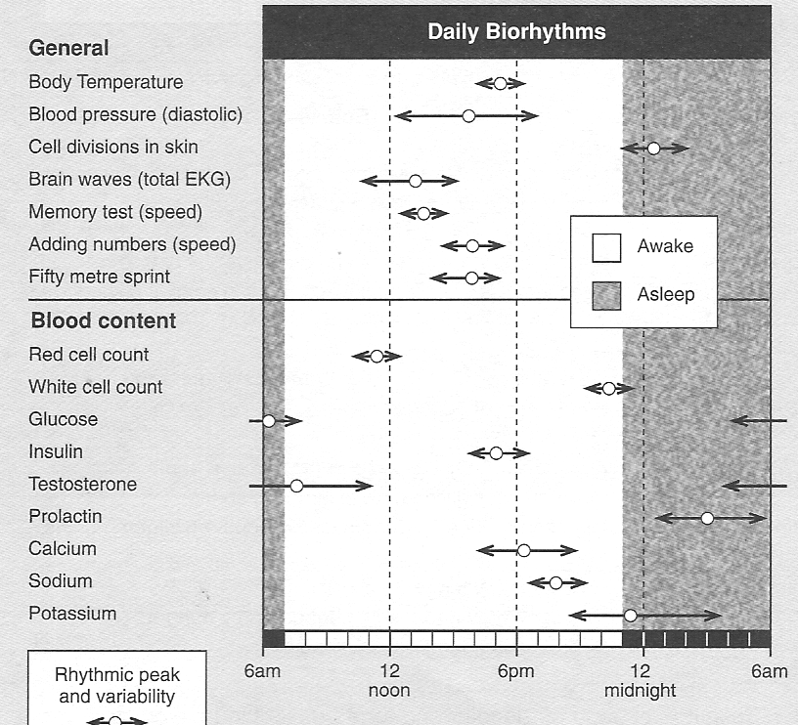

Slide 8
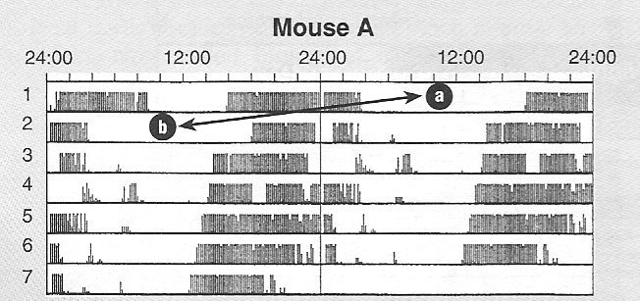
Using an actogram
The actogram below shows the activity rhythm of a mouse for kept in constant dim light for 7 days. A running wheel connected to a computer was used.
The ‘a’ and ‘b’ are the same day. Days are plotted twice to help you see the rhythm

Slide 9
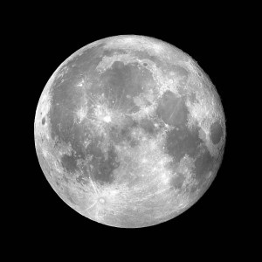
Circalunar rhythms
Possibly a relationship with human female menstrual cycle but it is not synchronised with the lunar cycle

Slide 10
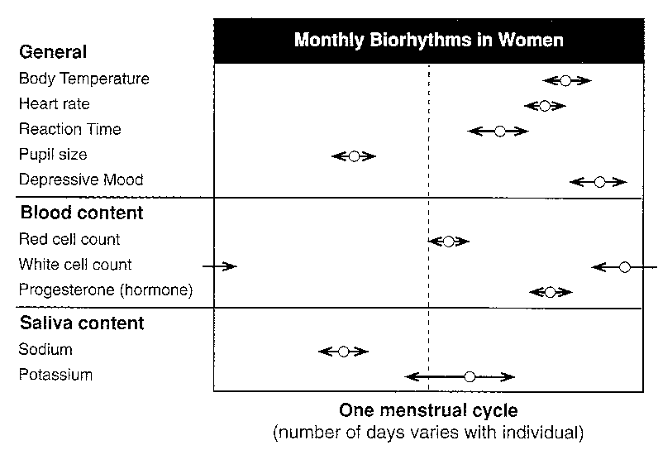

Slide 11
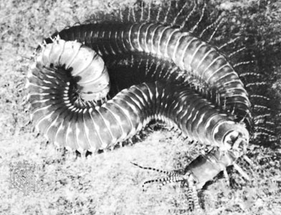
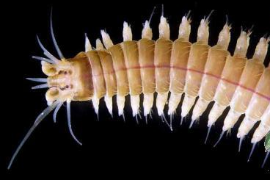
Palolo Worms
Palolo are about 12 inches long and live in burrows dug into the coral reef. They have two sections. The front section is the basic segmented worm with eyes, mouth, etc., followed by a string of segments that contain reproductive gametes.

Slide 12
When it comes time to spawn, palolo release the back section from their body.
The sections then twirl around in the water in vast numbers. Around daybreak, the segments dissolve and release the eggs and sperm that they contain.
The fertilized eggs hatch into small larvae that drift with the plankton. the survivors settle on a coral reef to begin life anew.

Slide 13
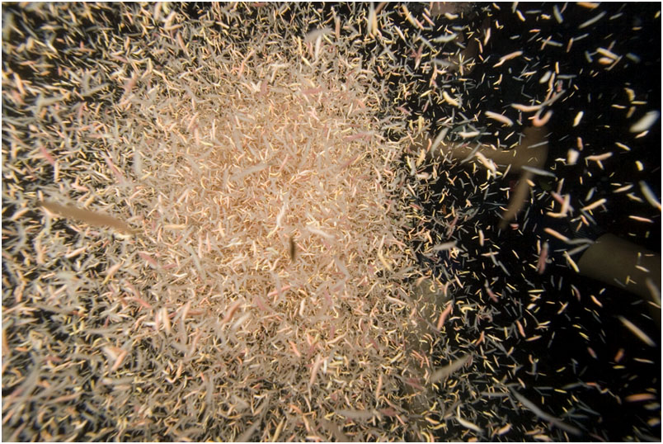
Palolo reproductive segments

Slide 14
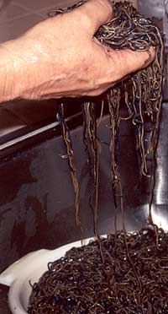
This is a classic example of coordinated mass spawning.
The worms emerge from their burrows during a specific phase of the moon.
The swarms occur on the evenings of the last quarter moon of spring or early summer.
In Samoa, this is seven days after the full moon in October or November. Swarming occurs for two or three consecutive nights.

Slide 15
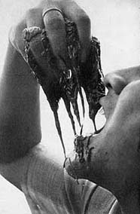
Palolo is considered a delicacy by the islanders

Slide 16
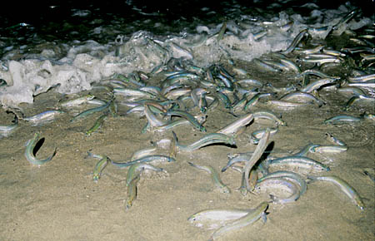
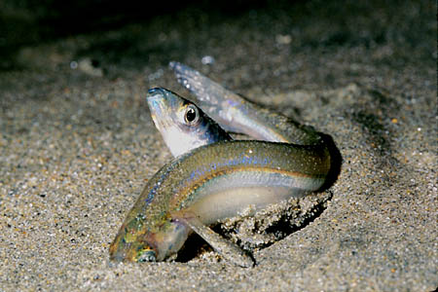
Circatidal rhythms
Grunion spawn on California beaches from April to June during high spring tides
Female
Male

Slide 17
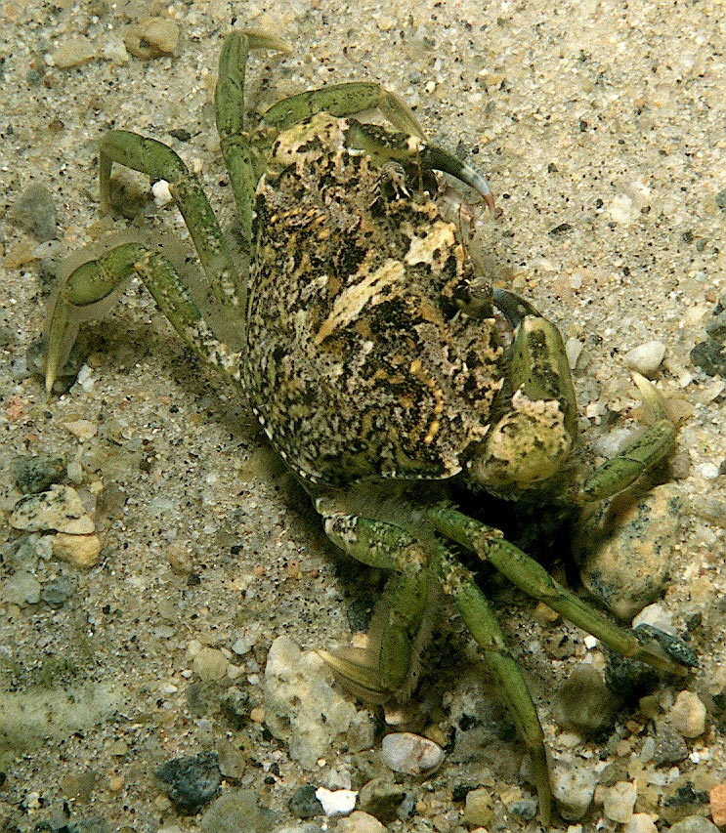
Shore crabs are active at high tide

Slide 18
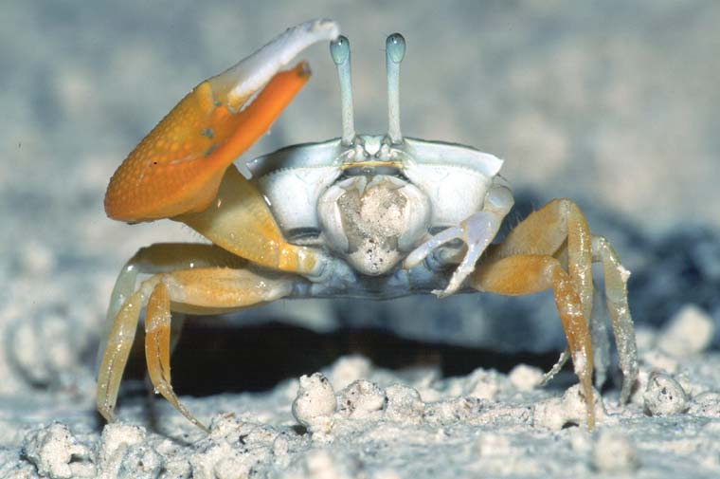
Fiddler crabs are active at low tide

Slide 19
Circannual rhythms
The tilt of the Earth’s axis of rotation produces the seasons.
Many animals show annual rhythms to cope with the changes in weather and food availability

Slide 20
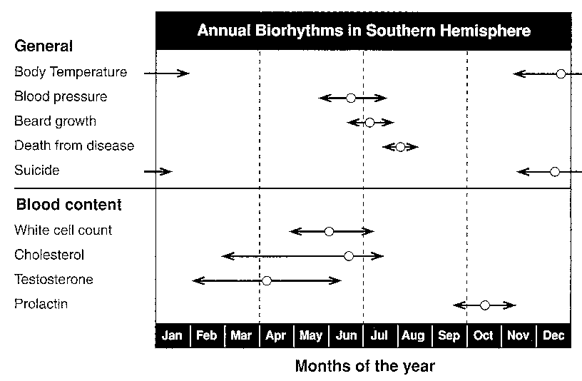
Human circannual rhythms

Slide 21
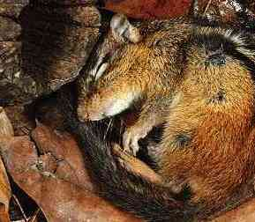
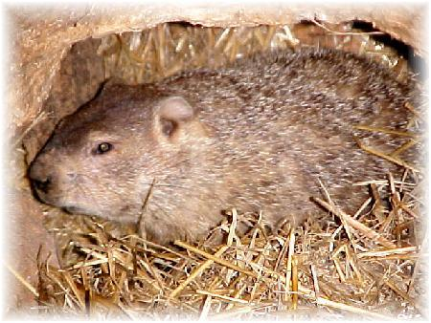
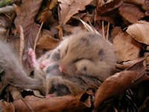
Hibernation
dormouse
Overwintering
An animal’s metabolic rate decreases greatly. The groundhog’s temperature drops from 36°C to about 6°C and its heart rate from 80 down to 5 beats per minute
Japanese dormouse

Slide 22
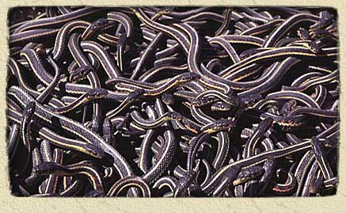
1000’s of red sided garter snakes hibernate together in caves in Canada

Slide 23
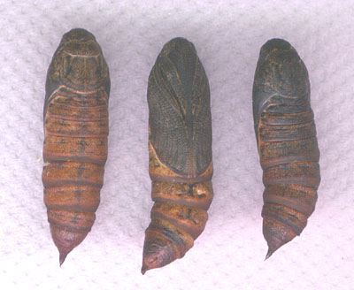
Diapause
This is insect hibernation. Many insects overwinter as pupae in diapause, e.g. silk moths.

Slide 24

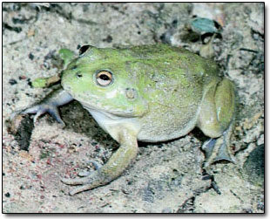

Aestivation
Summer hibernation
Worms, snails, frogs and some fish can survive long periods of dry conditions by going into a dormant state

Slide 25
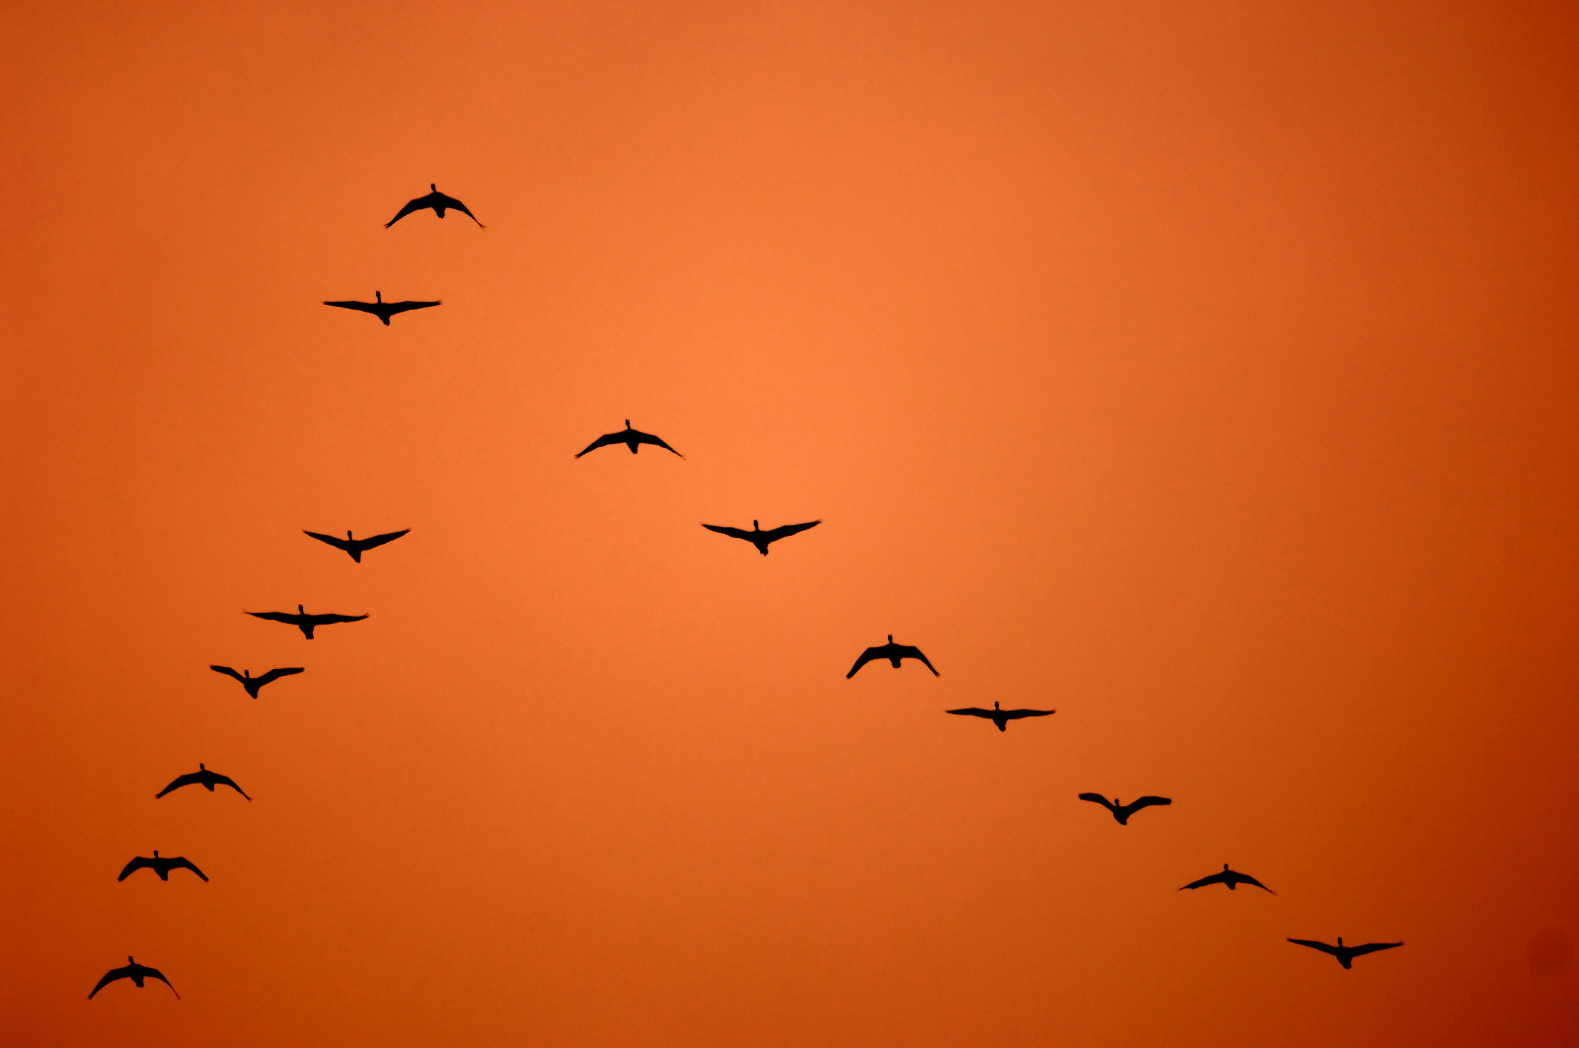
Migration

Slide 26
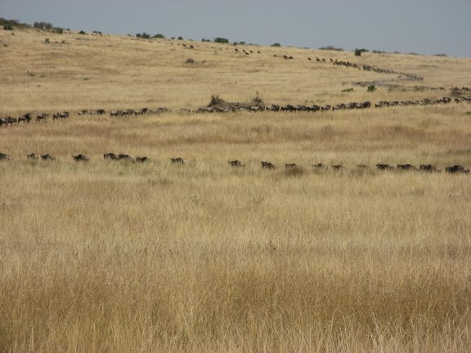

Slide 27
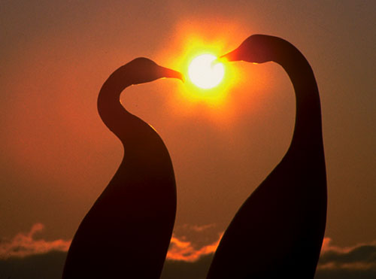
Reproduction
Animals reproduce at a time of year when their offspring will have the best chance to survive

